Slide 1

Argument completers for the untrusting admin
Ben Reader

Slide 2





Thanks to our sponsors:
#PSSATKA

Slide 3
“Guide your users to success with controlled inputs and bomb-proof input validation”
#PSSATKA

Slide 4
Agenda
Problem 1: We need keys (becoming a locksmith)
Problem 2: The keys don’t work (VALIDATION!)
Problem 3: We need MORE keys!
Deep dive in the kiddy pool: Argument Completers
Cloud Config?
#PSSATKA

Slide 5
“Hey, our team needs to access the database securely… can you help?”
#PSSATKA

Slide 6
#PSSATKA

Slide 7
What we know…
Project name: ProjectX
Multiple databases:
DB1
DB2
DB3
DB4
Access should be temporary
#PSSATKA

Slide 8

DEMO
#PSSATKA

Slide 9
“Hey, that script isn’t working… Can you fix it?”
#PSSATKA

Slide 10
#PSSATKA

Slide 11
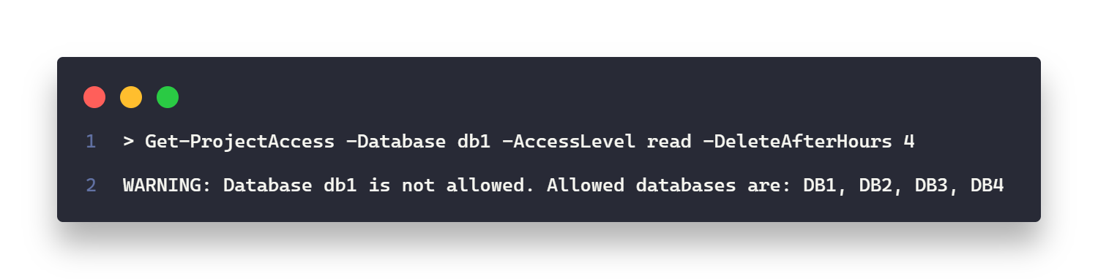
What we know…
Users are running the script and it’s throwing errors if the database names have incorrect casing – “db1” is NOT “DB1”.
#PSSATKA

Slide 12
DEMO
#PSSATKA

Slide 13
“Hey, we uh… have a new project… Can you update that script?”
#PSSATKA

Slide 14
#PSSATKA

Slide 15
What we know…
New project: NewHotness
Has it’s own databases:
Audit
Customers
Secrets
Espionage
Weaponry
Access should be temporary
#PSSATKA

Slide 16
What we also know…
We should probably move the configuration out of the actual code…
#PSSATKA

Slide 17
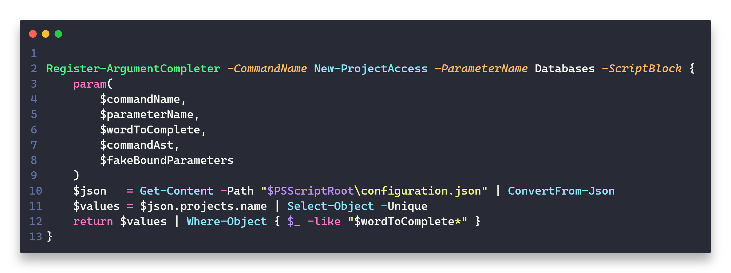
#PSSATKA

Slide 18
“Hey, uh… We’ve got another project… One more time???”
#PSSATKA

Slide 19
#PSSATKA

Slide 20
What we know…
New project: OldColdness
Has it’s own databases:
Bribes
Blackmail
WitnessTampering
Access should be VERY temporary
#PSSATKA

Slide 21
What we also know…
Updating this solution is getting boring…
Can we push the configuration somewhere so someone else can handle these change requests?
#PSSATKA

Slide 22

Rate this session
Giving feedback is like wrapping a Christmas gift: thoughtful, personal, and meant to bring joy.
#PSSATKA

Slide 23
Thanks for your attention and all the fish
#PSSATKA

